Slide 1

Japan
Group Assignment:
Data Science for Energy System Modelling
By Group I:
Karim Shawky
Pablo Rychtyk
Jay Khatanhar
Haythem Rezgui

Slide 2
Goal
Investigate a 100% renewable energy system for Japan
Shaping
Renewable Energy Pot.
Building a PyPSA Model
Investigation
Conclusion
Split the country in regions to simplify the simulation process
Calculate the potential by combining available land with the weather data
Analysis based on the regional load and available
renewable potential
Alter the model in two different manners to analyse robustness and input factors’ impact

Slide 3
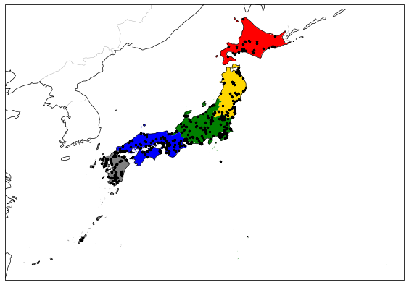
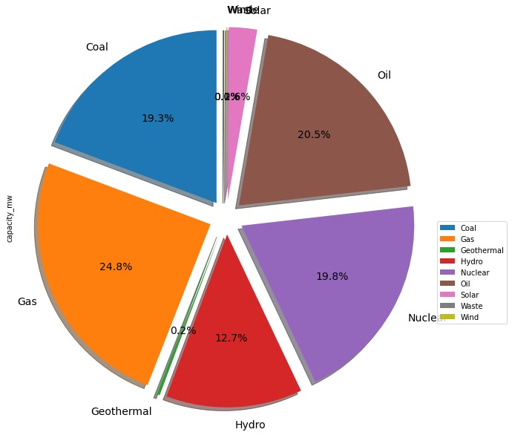
Shaping
Waste Wind Solar
Japan’s 2013 power distribution is shown in the following
pie chart
Split the country into 5 regions as the figure shows
Powerplants are highlighted with the black markers
Used ISO codes to group the prefectures together

Slide 4
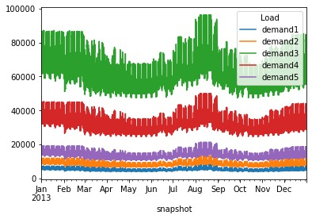
PyPSA
PyPSA model uses the weather data from 2013
Cost of electricity: 16.73€/MWh

Slide 5
Renewable Energy Potential
Build the excluders* for each of the regions
Offshore wind analysis was an exception:
EEZ zone had to be excluded from the mainland
A turn around due to the complexity of a straightforward
implementation
*: Excluded areas are shown in additional slides

Slide 6
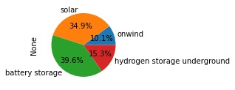
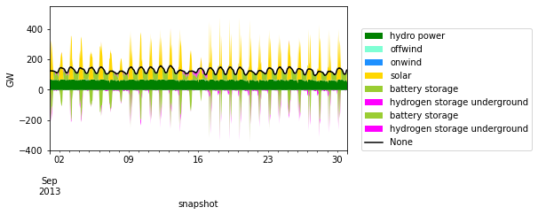
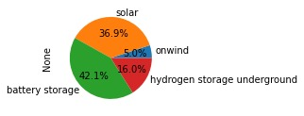

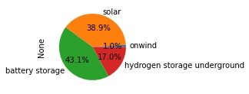
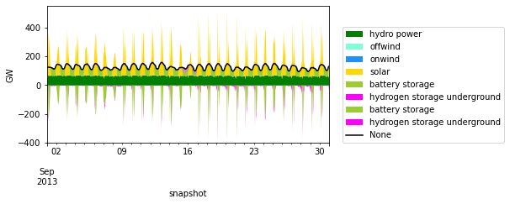


Investigation
Cost reduction factor: 0.8
16.61 €/MWh
Cost reduction factor: 0.85
16.69 €/MWh
Cost reduction factor: 0.9
16.72 €/MWh
Cost reduction factor: 0.95
16.72 €/MWh

Slide 7
Thank you for your Attention

Slide 8
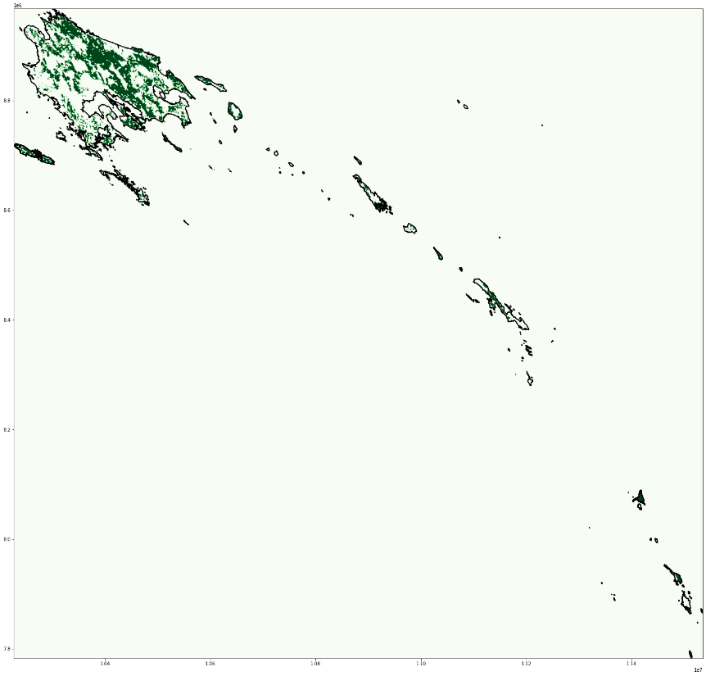
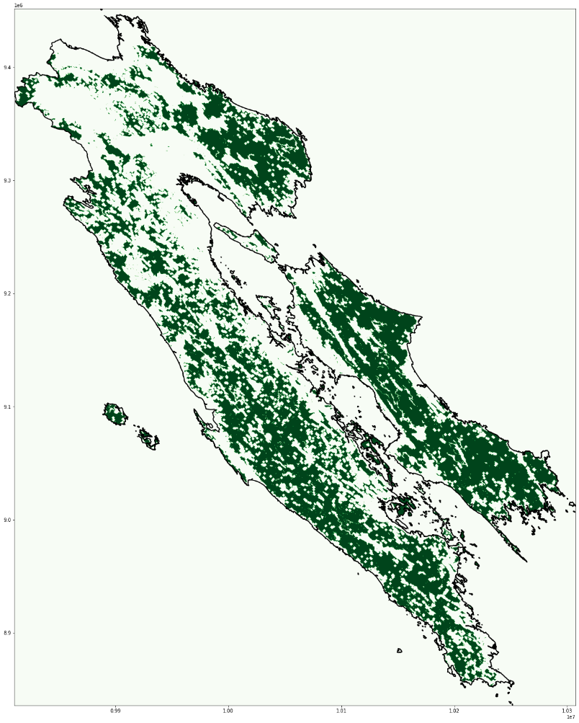
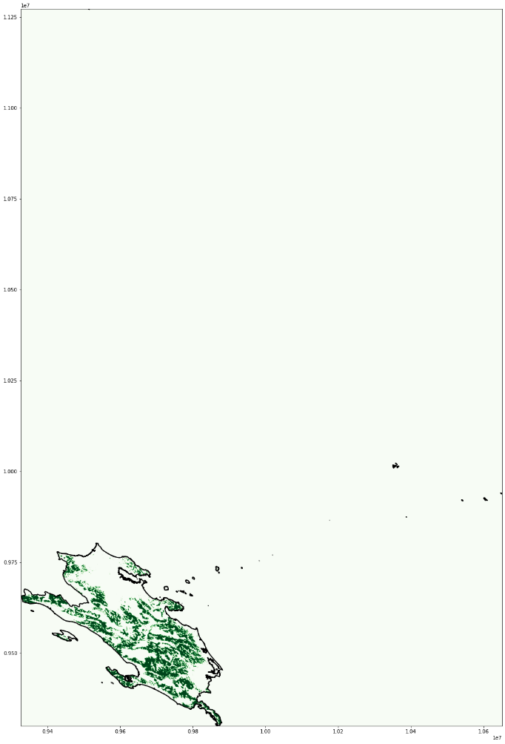
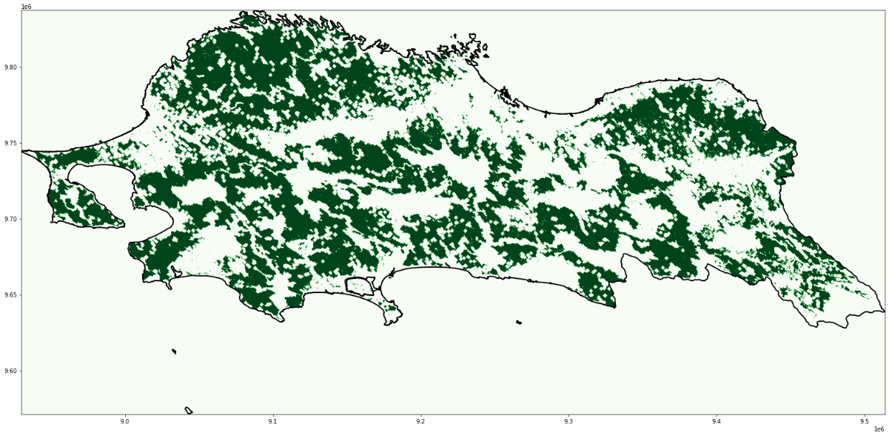
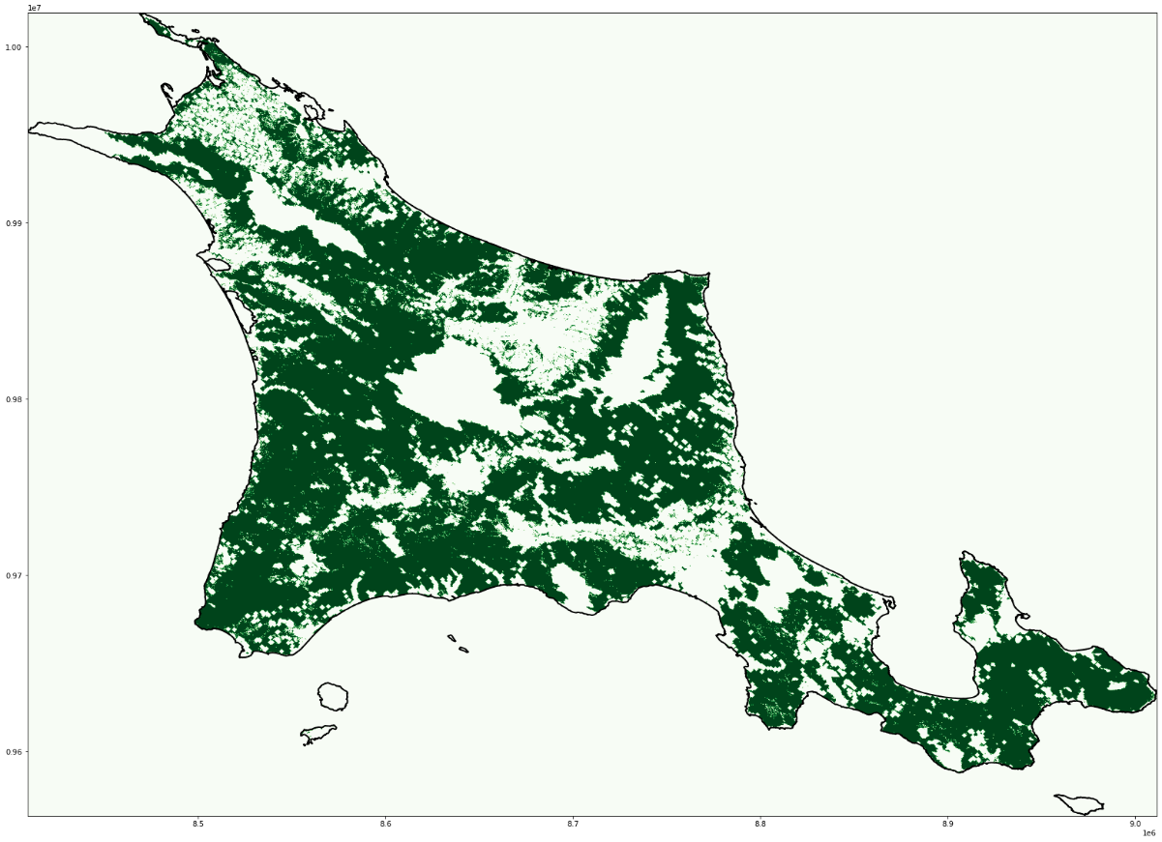
Additional Slides
→ Eligible areas for onshore wind power generation:

Slide 9
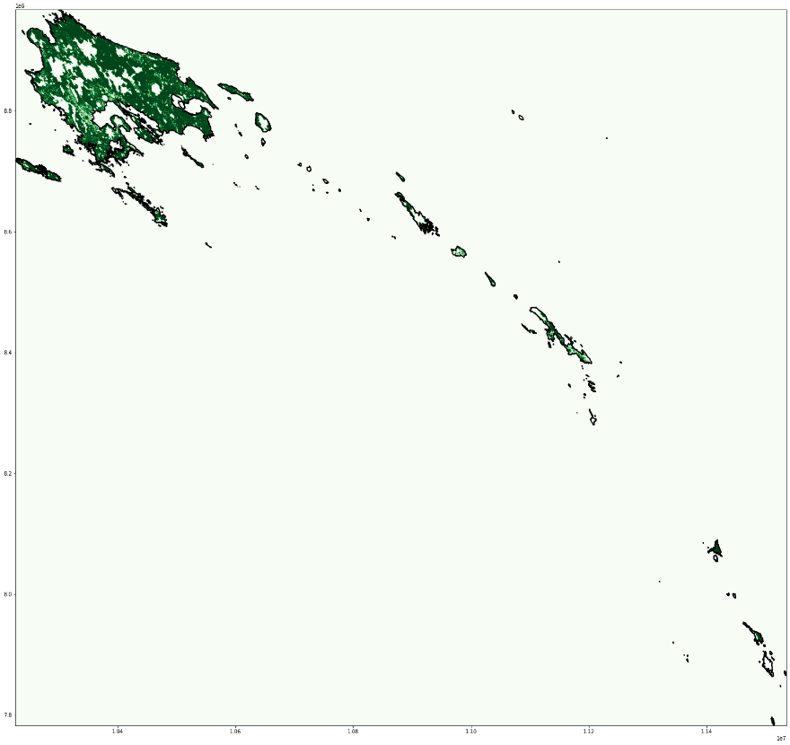
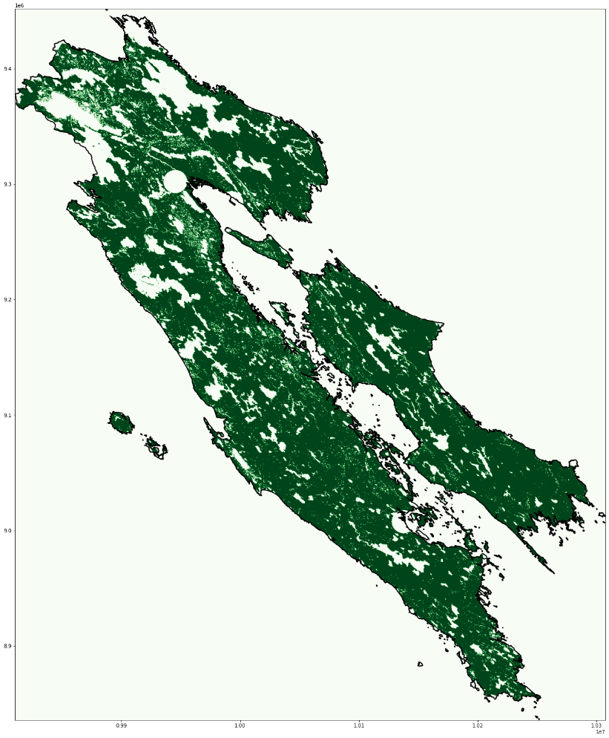
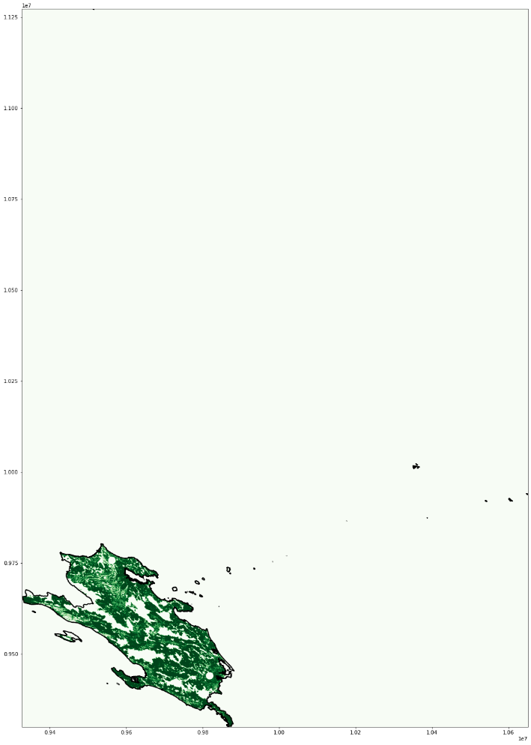
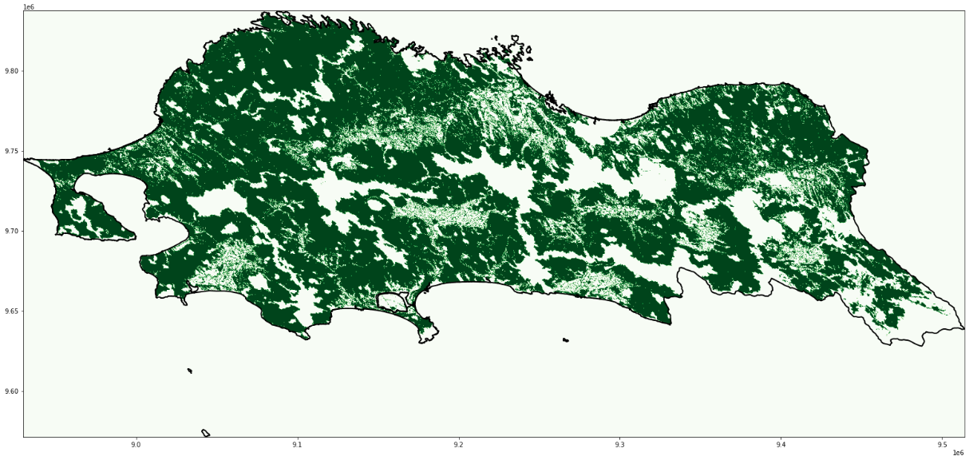
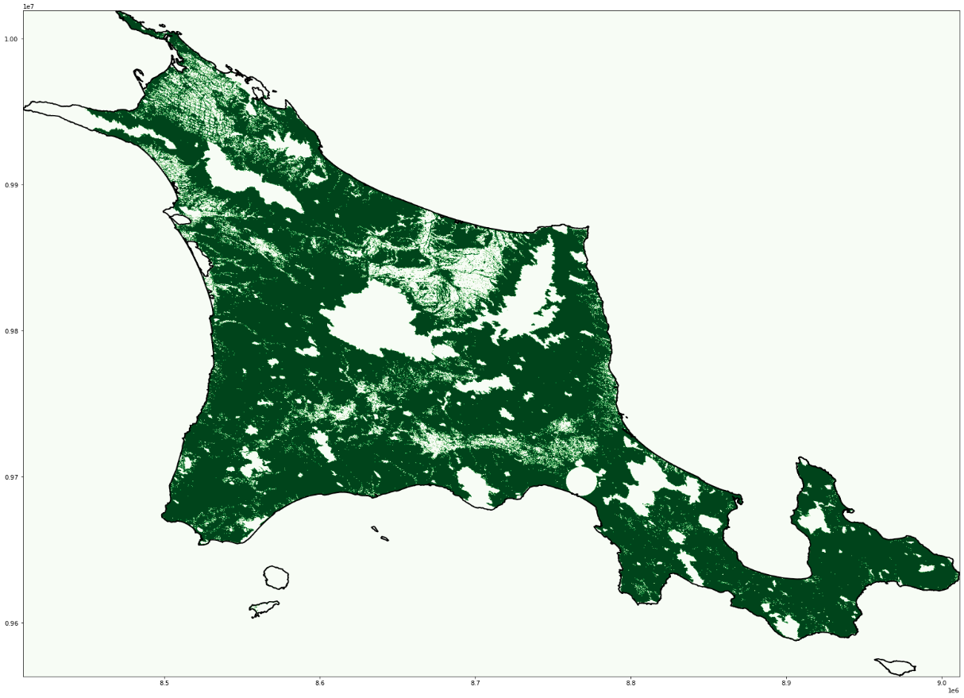
Additional Slides
→ Eligible areas for solar power generation:

Slide 10
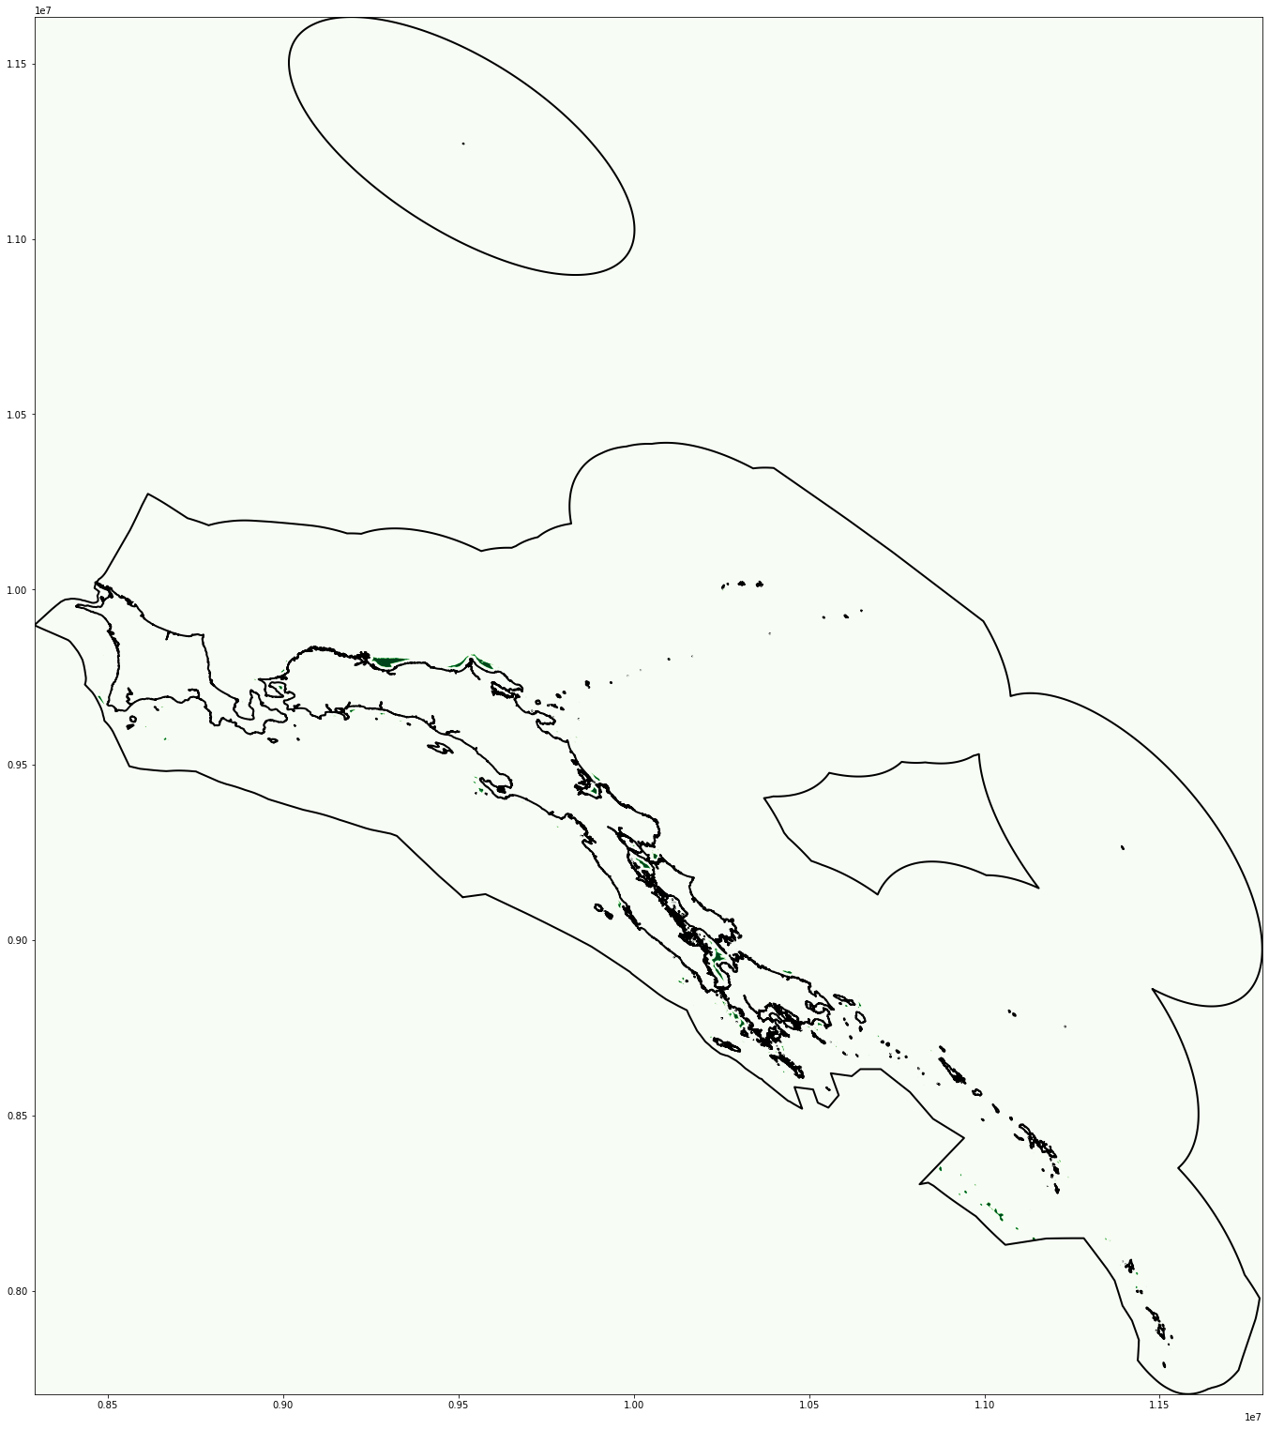
Additional Slides
→ Eligible areas for Offshore wind power generation:

